Slide 1



Online Communication Skills
Making use of Zoom
www.shared-interest.com

Slide 2

www.shared-interest.com

Slide 3
Recording your presentation
www.shared-interest.com

Slide 4
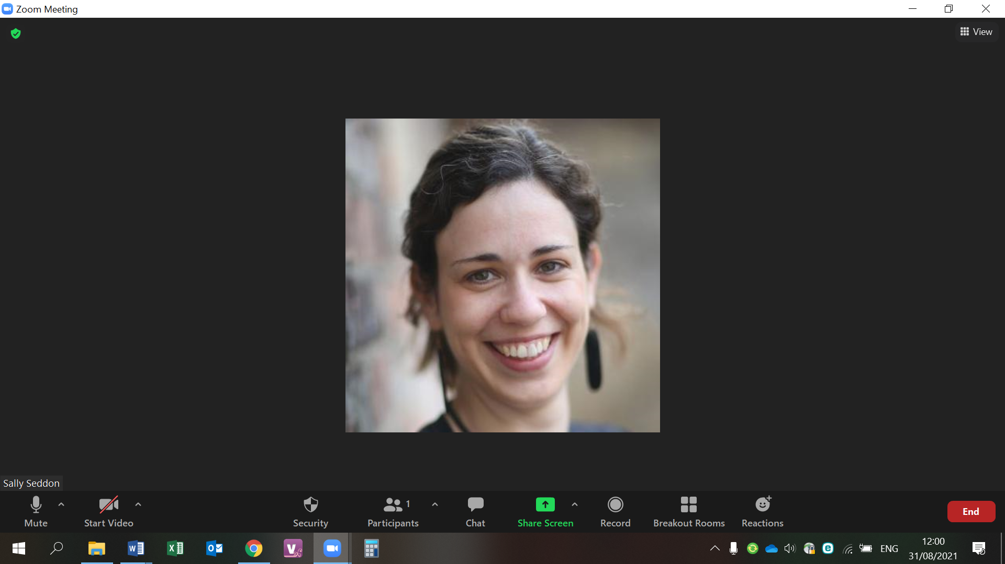
www.shared-interest.com

Slide 5
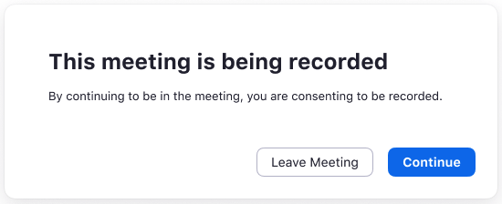
www.shared-interest.com

Slide 6
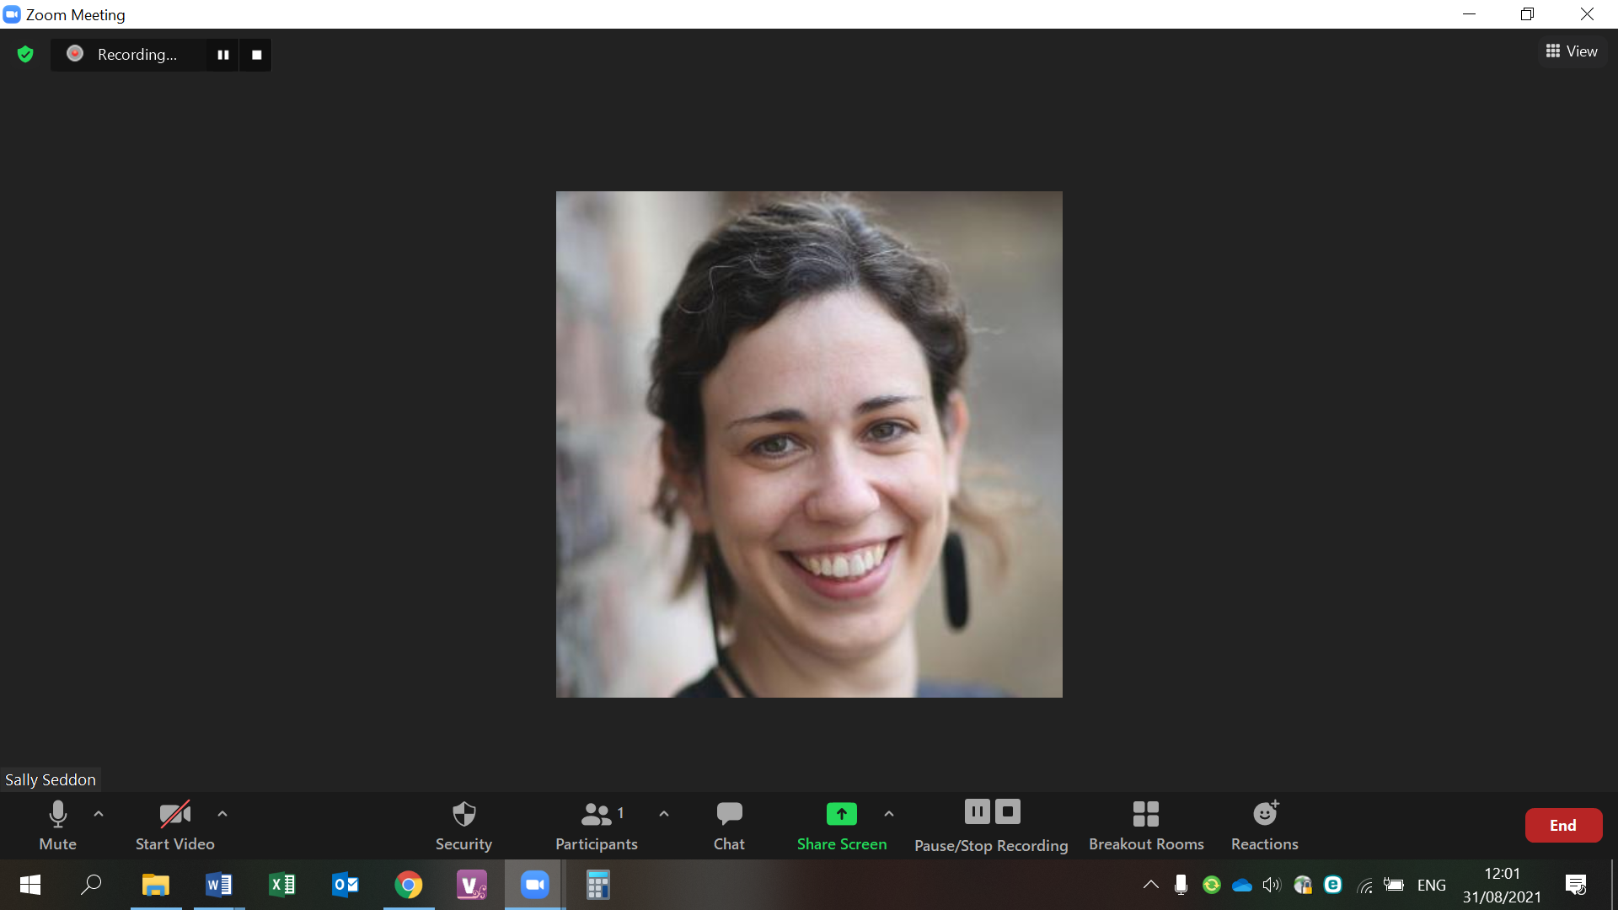
www.shared-interest.com

Slide 7
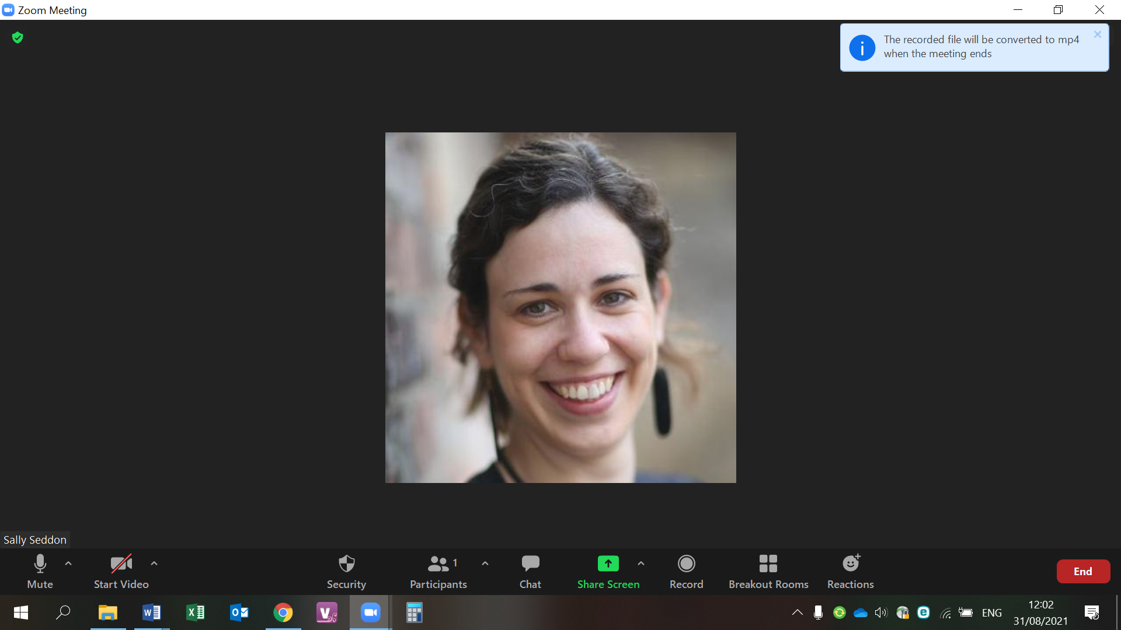
www.shared-interest.com

Slide 8
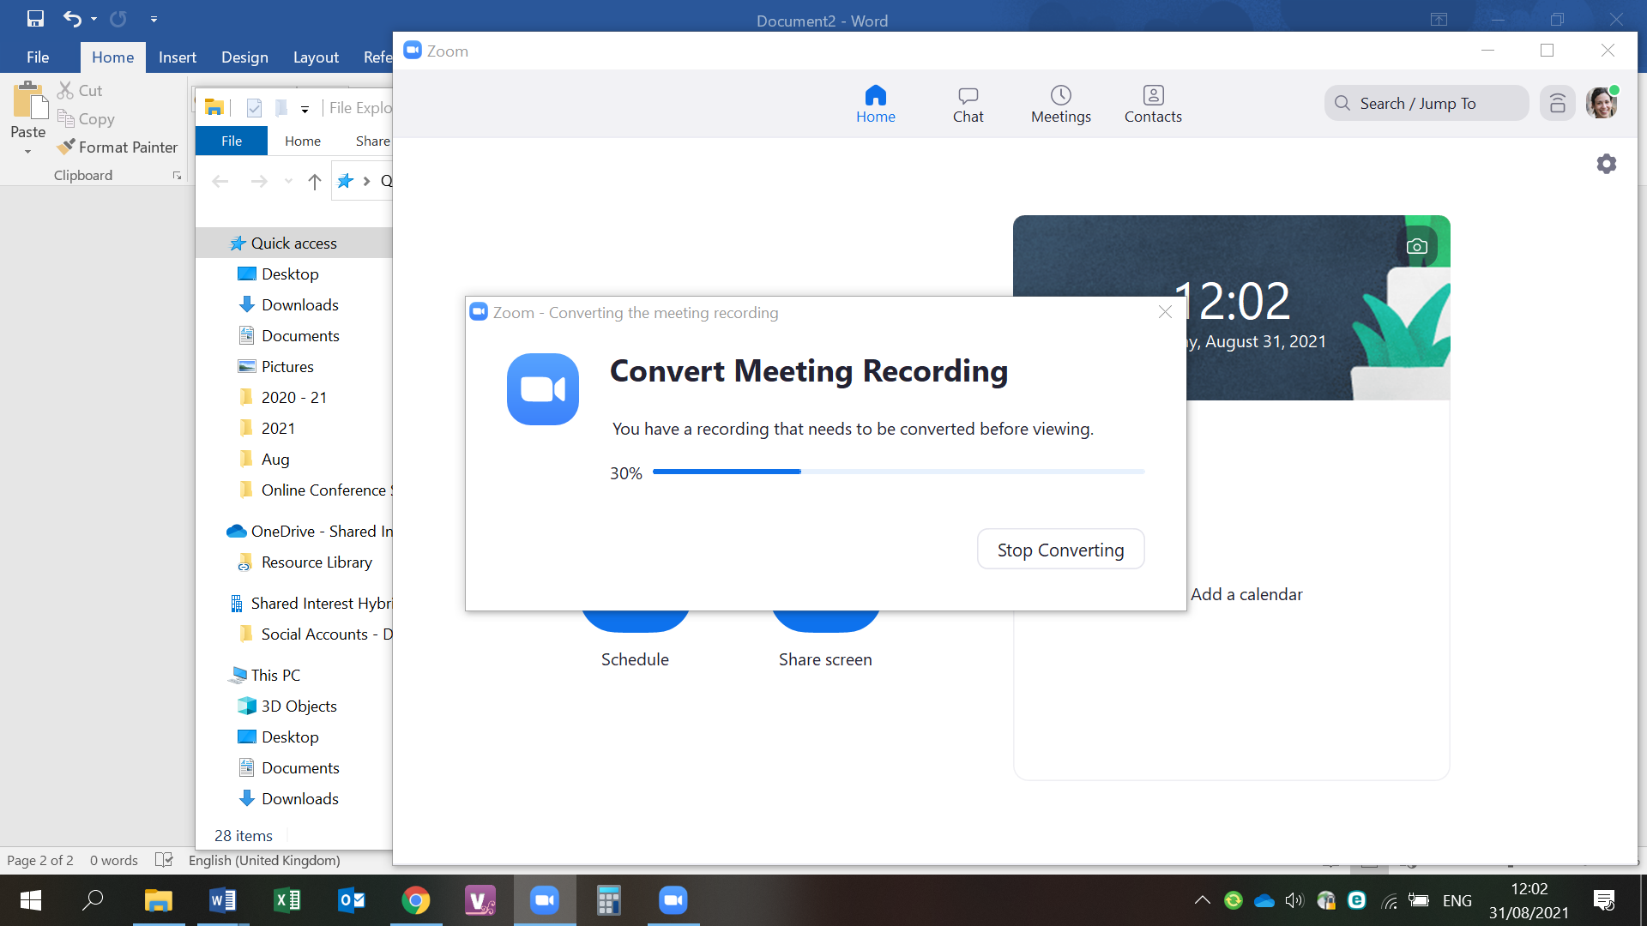
www.shared-interest.com

Slide 9
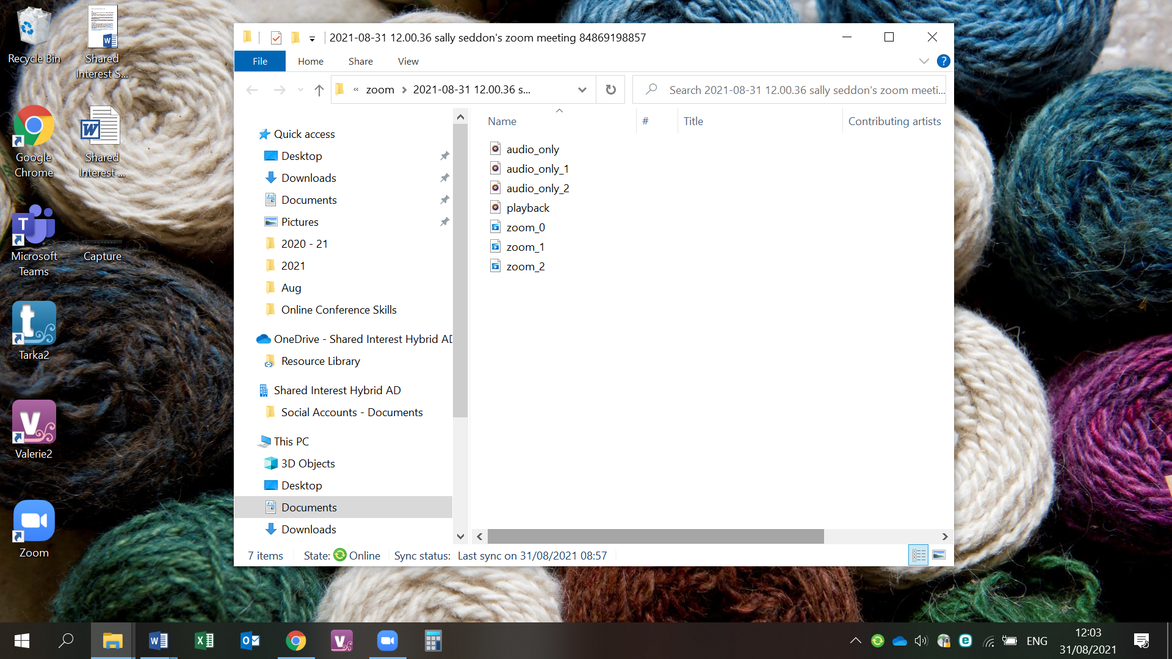
www.shared-interest.com

Slide 10
Showing video / audio
www.shared-interest.com

Slide 11
www.shared-interest.com

Slide 12
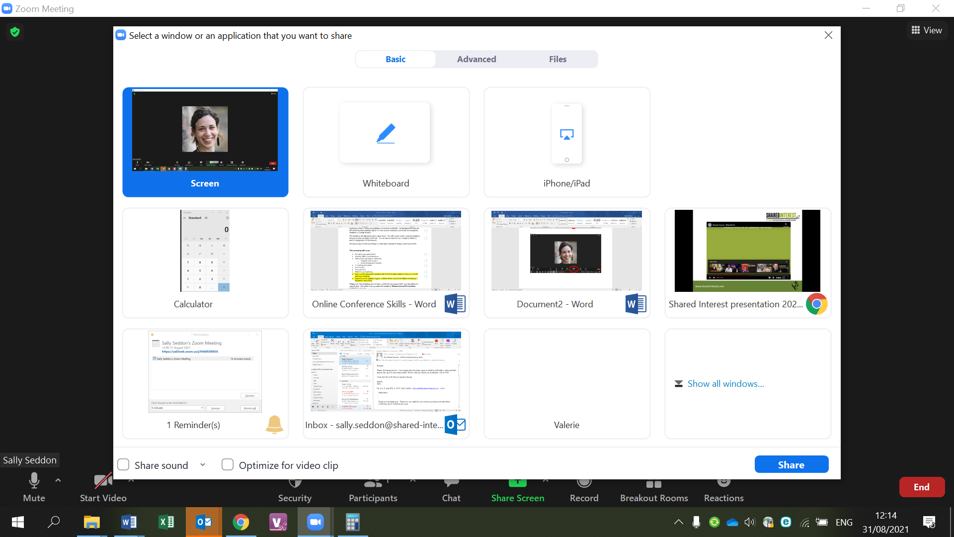
www.shared-interest.com

Slide 13
Using the chat function
www.shared-interest.com

Slide 14
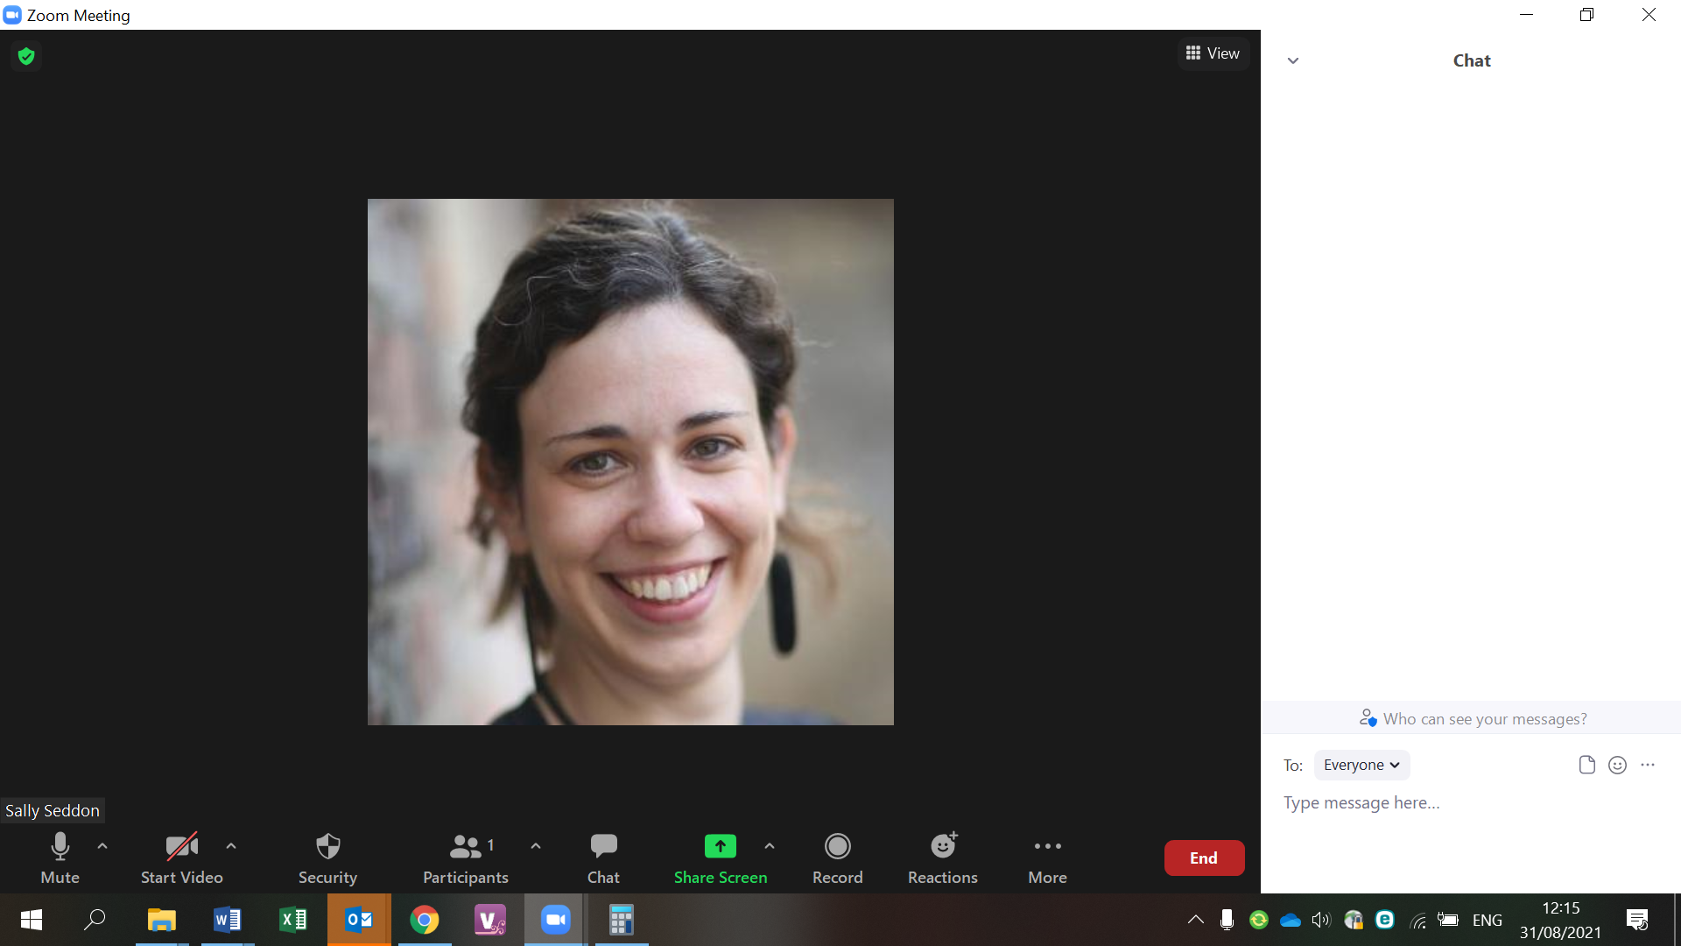
www.shared-interest.com

Slide 15
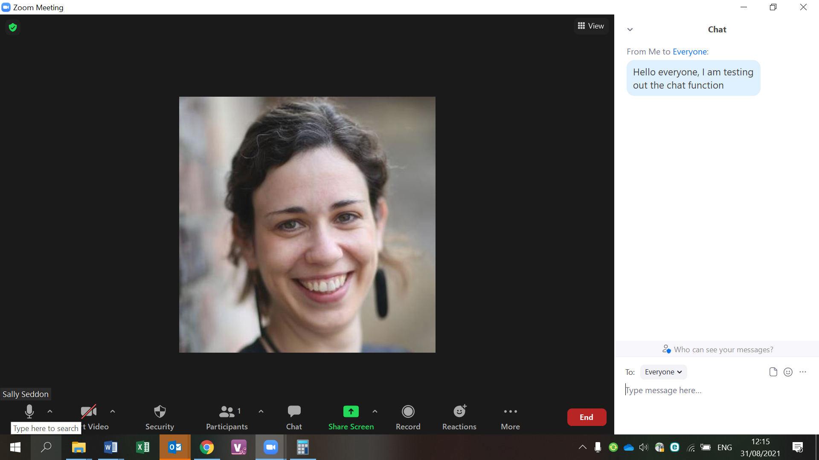
www.shared-interest.com

Slide 16
Using the reactions function
www.shared-interest.com

Slide 17
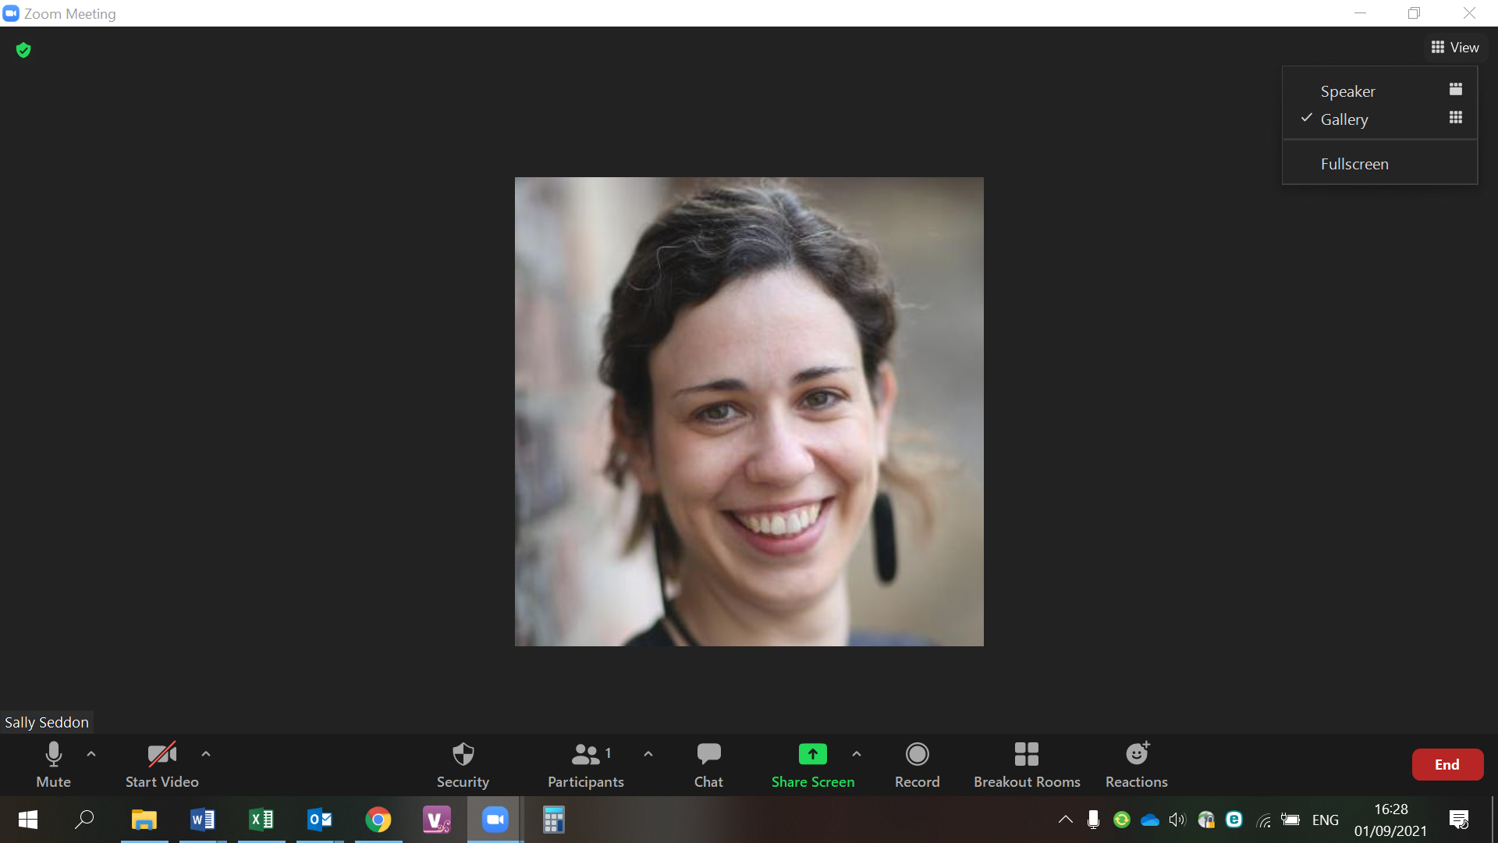
www.shared-interest.com

Slide 18
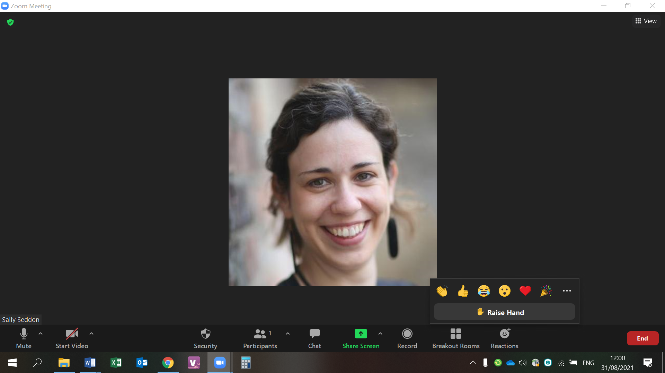
www.shared-interest.com

Slide 19
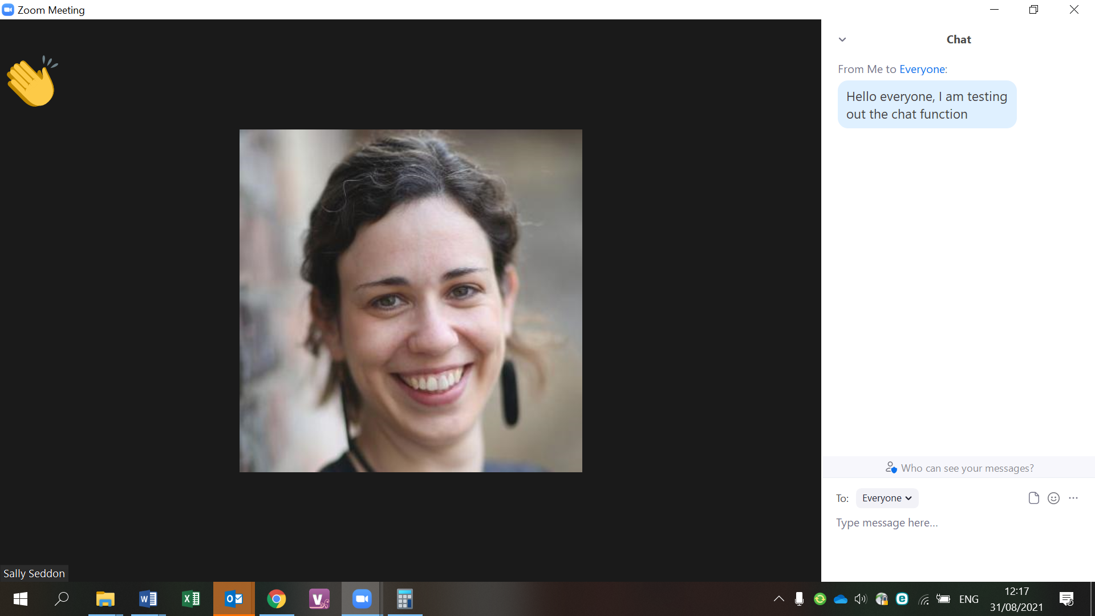
www.shared-interest.com

Slide 20
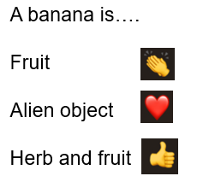
www.shared-interest.com

Slide 21
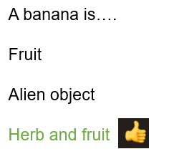
www.shared-interest.com

Slide 22
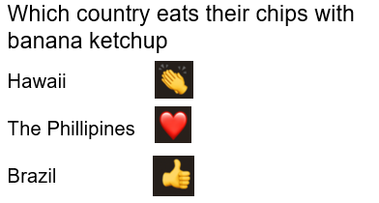
www.shared-interest.com

Slide 23

www.shared-interest.com

Slide 24
Checking for Zoom updates
www.shared-interest.com

Slide 25
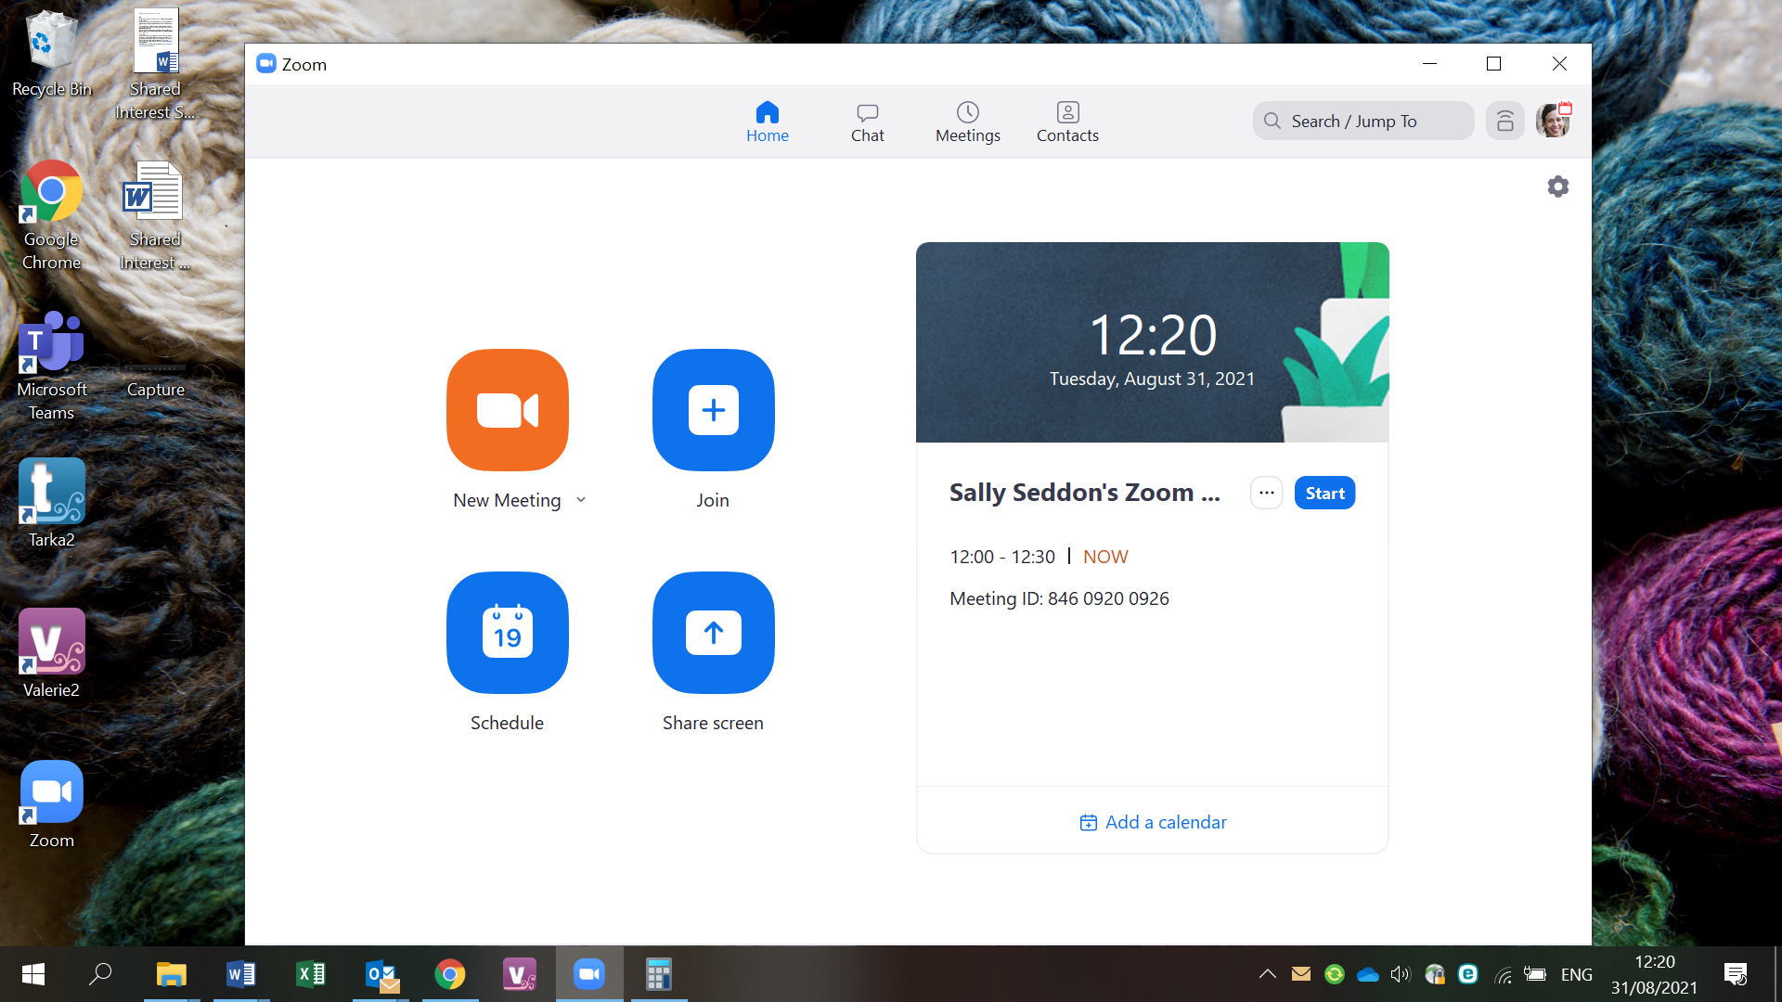
www.shared-interest.com

Slide 26
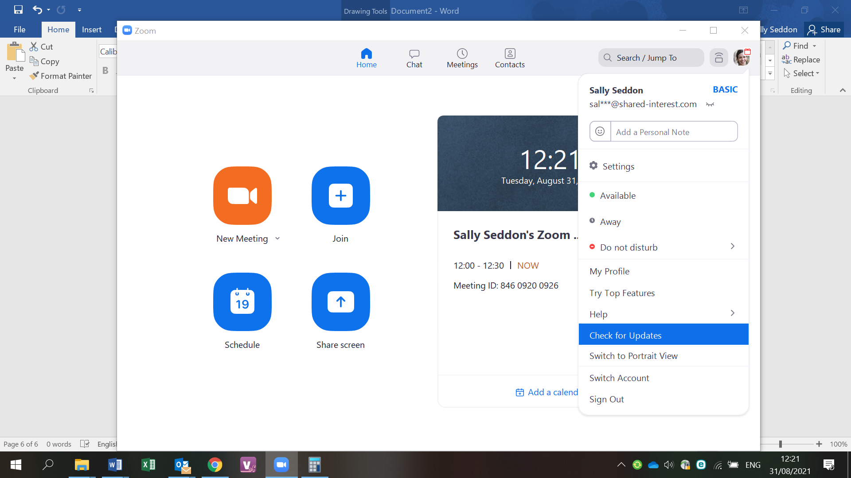
www.shared-interest.com

Slide 27
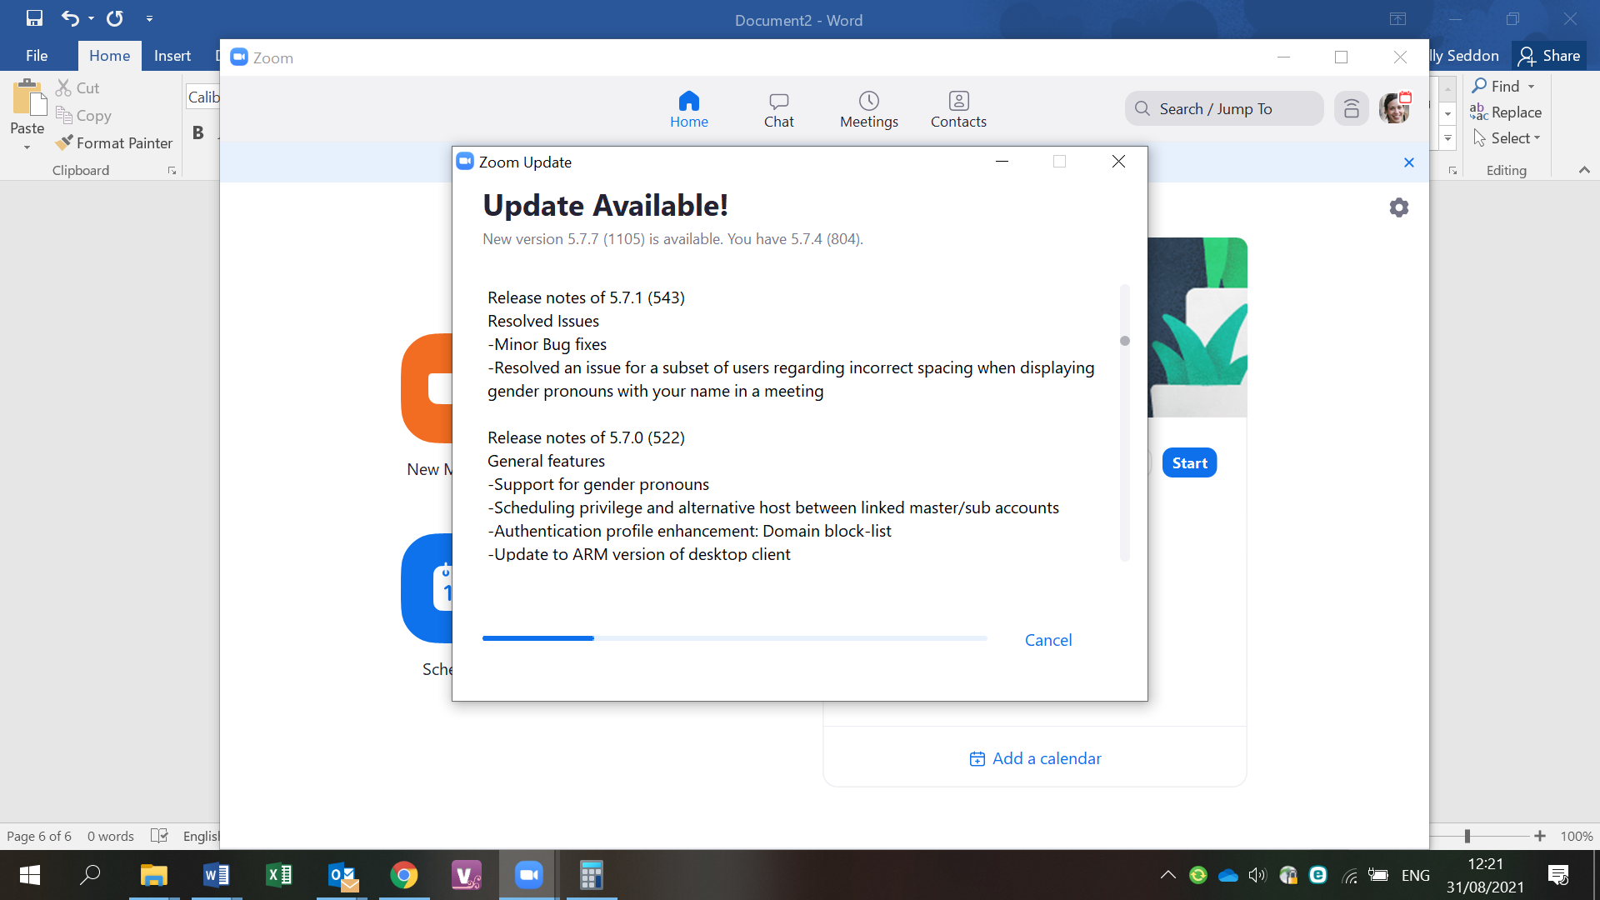
www.shared-interest.com

Slide 28
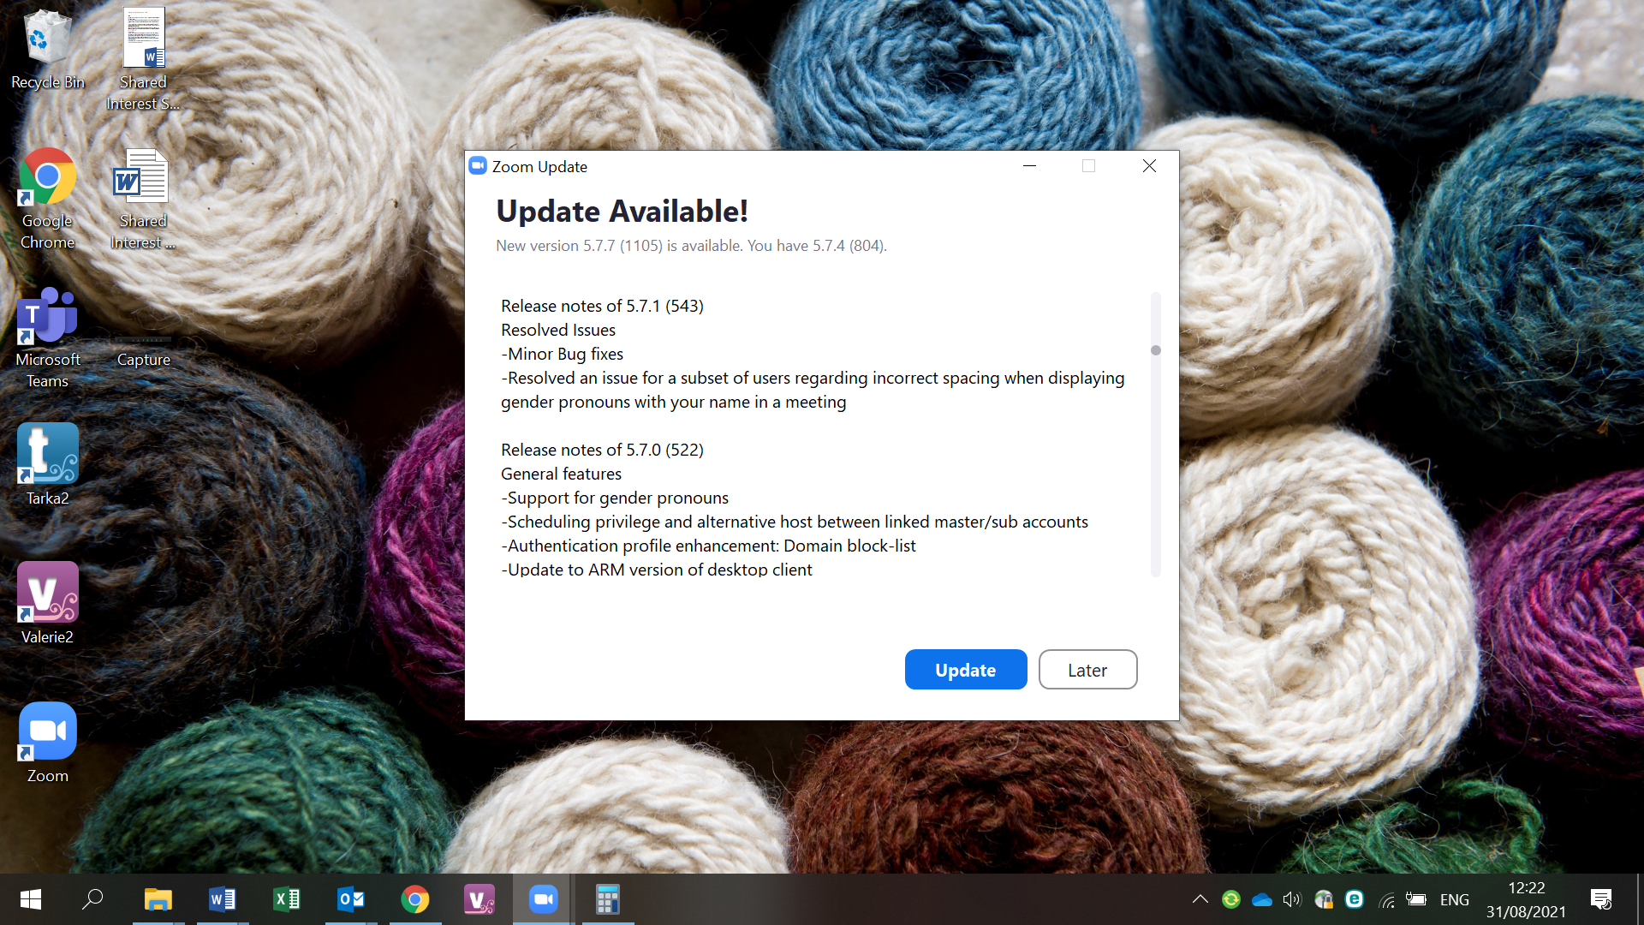
www.shared-interest.com

Slide 29
Where to get more help
https://support.zoom.us/hc/en-us
www.shared-interest.com

